Slide 1
Modulation Methodology for Concurrent Power Transfer for Field Excitation

Slide 2
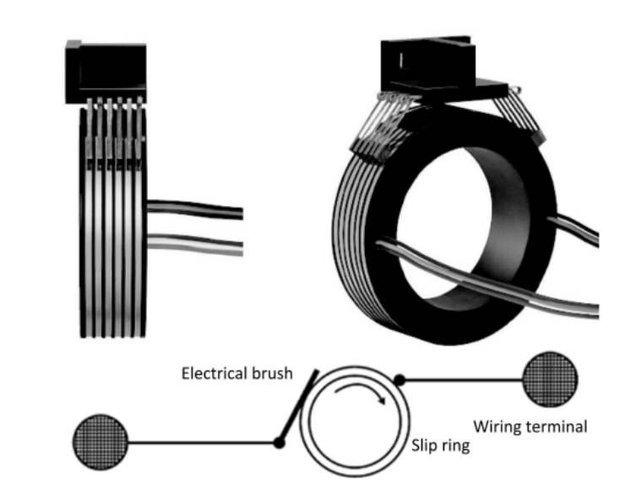
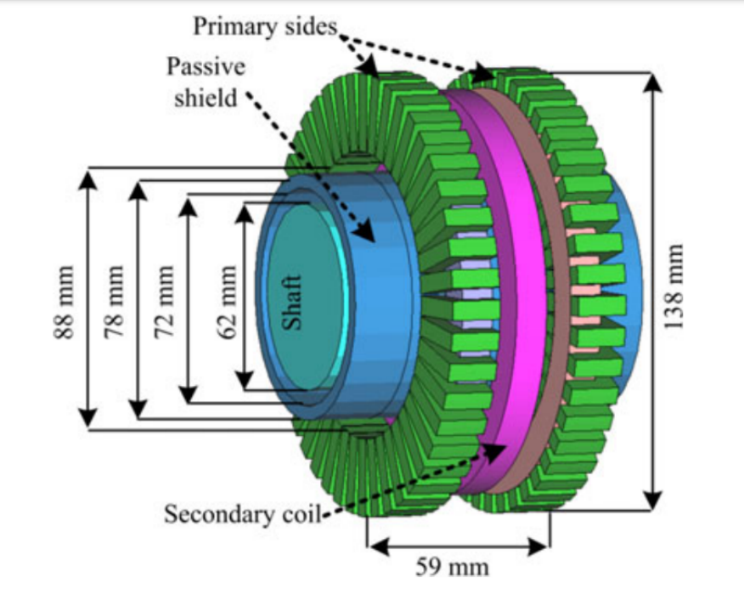
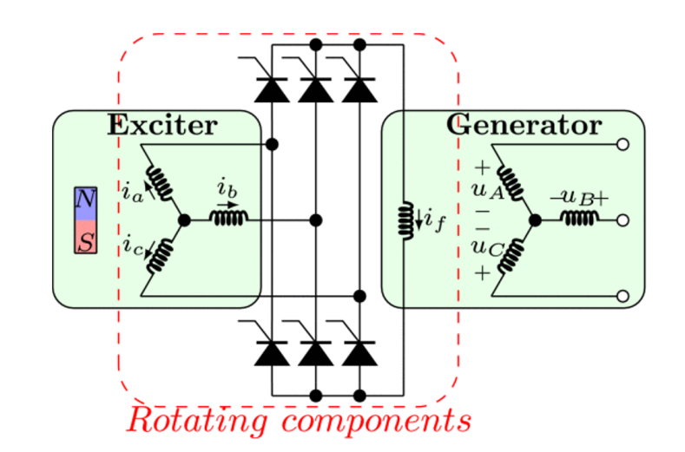
Power Transfer to Rotating Frames
 | Slip Rings | Brushless Exciters | Contactless Slip Rings
Reliability | - | + | +
Maintenance | - | + | +
Simplicity | + | + | -
Speed Independency | + | - | +
Cost Effectivity | + | + | -
Efficiency | + | - | +

Slide 3
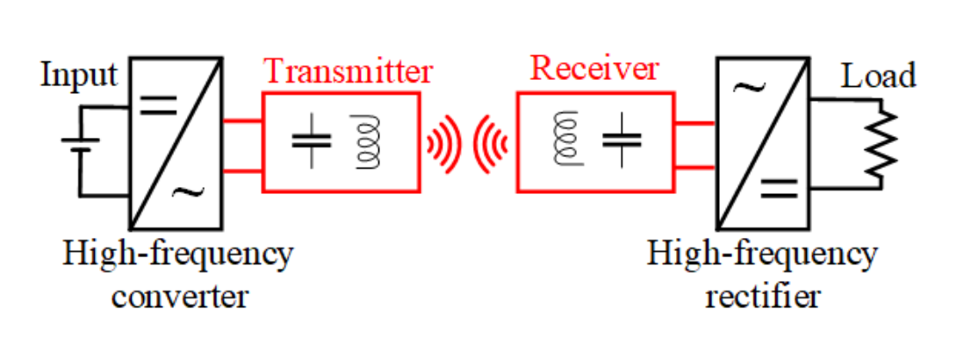
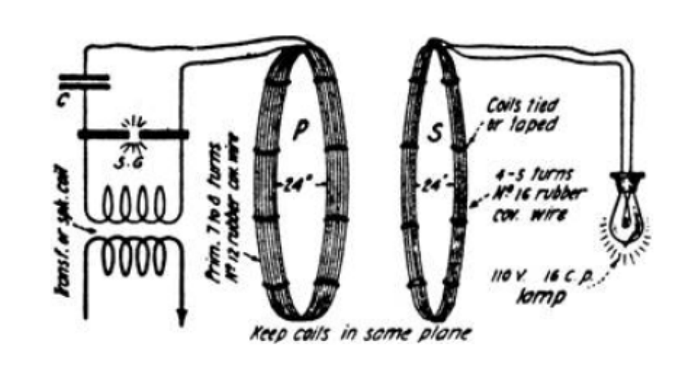
Wireless Power Transfer
DC/AC Converter
Compensation Circuits
Transmitter/Receiver Coils
AC/DC Rectifiers
 | Inductive Power Transfer | Capacitive Power Transfer
Transfer Type | Varying MF | Varying EF
Power Ratings | High | Low
Frequencies | Low | High
Efficiency | High | High
Distance | Moderate | Low
Tesla’s WPT System

Slide 4
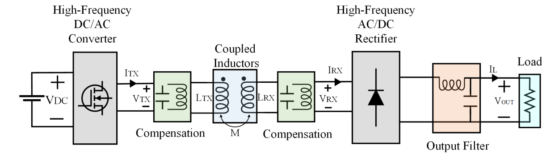
Inductive Power Transfer System

Slide 5
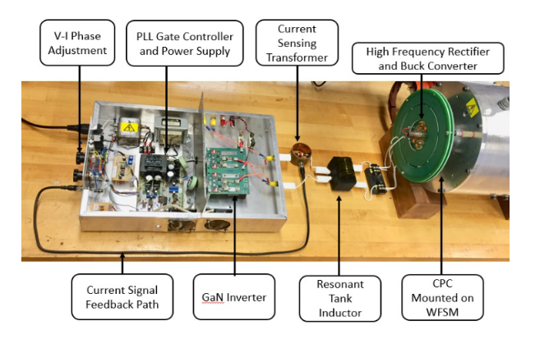
Aim : Merging Concurrent Power Transfer System with Slip Ring Applications
Contactless Slip Rings
Concurrent Power Transfer
Motivations:
To increase power
To reduce switching components
To increase DC-link utilization rate
To provide operation for more than one standards
Motivations:
To eliminate carbon brushes requiring periodic maintenance
To eliminate brushless exciters that are not suitable for variable speed drives
Topologies:
Multi-converter and multi-resonant
Single-converter and multi-resonant
Single-converter and multi-load

Slide 6
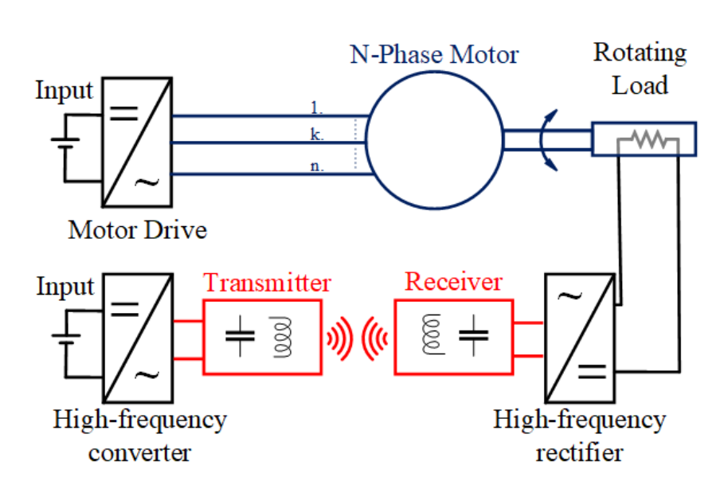
Conventional Inductive Power Transfer Based Contactless Slip Ring
Two converters:
  To drive the motor
  To excite the Tx coil
Field Winding
Motor → attenuated in motor current
The motor drive → generating low and high frequencies
Motor → used to drive
The WPT converter → generating high frequency
The WPT system →behaves like band-pass filter
Notes:
Our focus is on contactless slip rings.
Here, we have a representation of conventional contactless slip rings.
The common trait of these contactless slip rings; we have a motor drive system to achieve rotating load.
Inductive power transfer systems, a type of WPT system, are commonly used in such systems since they give a moderate transfer distance and higher efficiency.
IPT systems have four main parts: High-frequency converter, Transmitter, receiver, and high-frequency rectifier.
So, conventional contactless slip rings have two converters.
One of both is the converter of the motor drive.
Another is the high-frequency converter of the WPT system.
The motor drive also generates high-frequency switching components at the output, but the motor filters these components out.
A low-frequency modulating signal is used to drive the motor.
WPT converter generates high-frequency square waves, and Tx and Rx generally have band-pass filter characteristics.
Therefore, it only allows the desired high-frequency components to pass through.
Consequently, we have two converters in this system, which increase cost and complexity and decrease reliability.

Slide 7
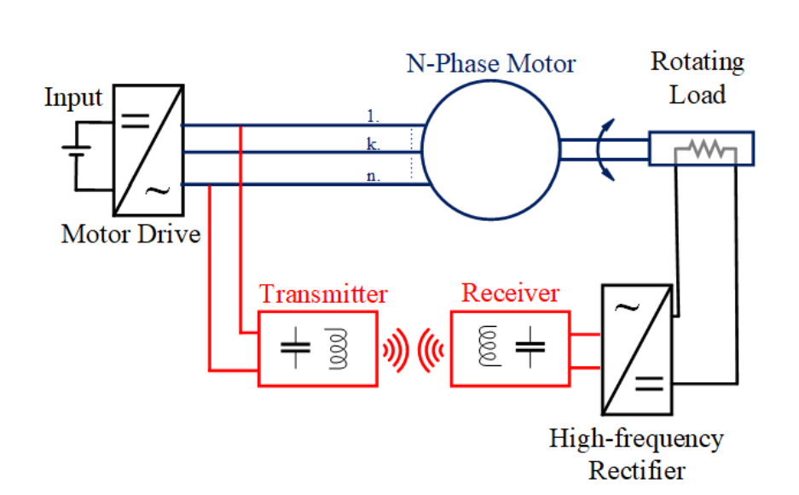
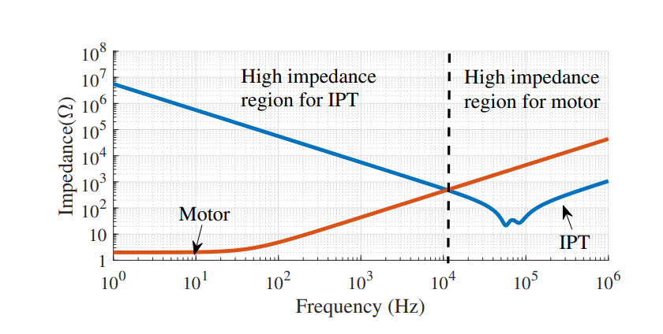
Proposed Inductive Power Transfer Based Contactless Slip Ring
The motor drive → generating high frequency
Field Winding
combining
The WPT system →behaves like band-pass filter
No longer required
The WPT converter → generating high frequency
Notes:
Our focus is on contactless slip rings.
Here, we have a representation of conventional contactless slip rings.
The common trait of these contactless slip rings; we have a motor drive system to achieve rotating load.
Inductive power transfer systems, a type of WPT system, are commonly used in such systems since they give a moderate transfer distance and higher efficiency.
IPT systems have four main parts: High-frequency converter, Transmitter, receiver, and high-frequency rectifier.
So, conventional contactless slip rings have two converters.
One of both is the converter of the motor drive.
Another is the high-frequency converter of the WPT system.
The motor drive also generates high-frequency switching components at the output, but the motor filters these components out.
A low-frequency modulating signal is used to drive the motor.
WPT converter generates high-frequency square waves, and Tx and Rx generally have band-pass filter characteristics.
Therefore, it only allows the desired high-frequency components to pass through.
Consequently, we have two converters in this system, which increase cost and complexity and decrease reliability.

Slide 8
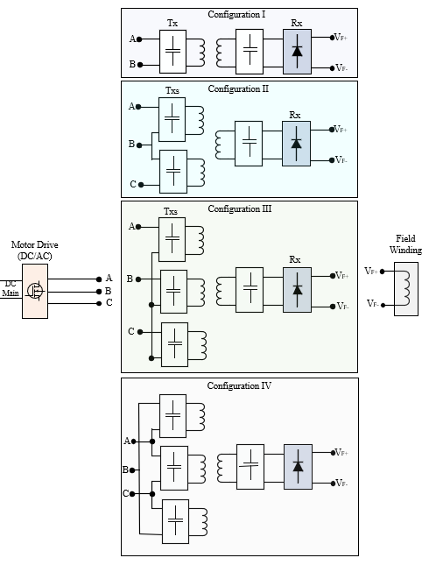
Possible Structures
Motor drives have more than 2 wires
Conventional WPT systems have 2 wires input
Multi-phase WPT systems
Motivations:
To increase DC-link utilization rate
To increase power
To break the restrictions

Slide 9
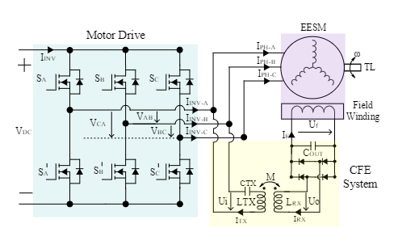
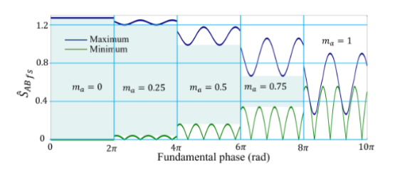
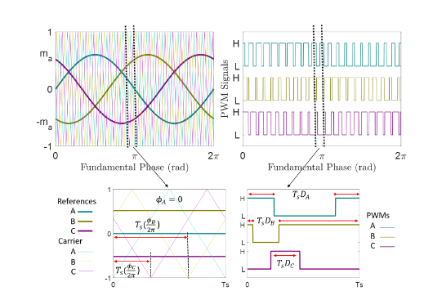
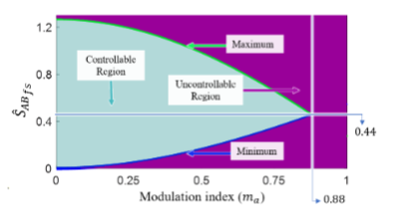
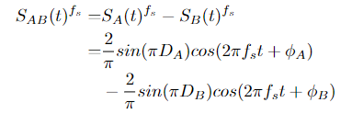
2-phase Utilization : Modulation Constraint
Notes:
The WPT system is connected between phase-A and phase B.
By carrier phase shift to phase B, we achieve this contour of the magnitude of the switching frequency.
We can observe that we can have a constant gain for any modulation.
The constant gain is between 0.25 and 0.45 over a DC-link voltage.
The control diagram is shown.
We adjust the carrier phase shift according to modulation to control the WPT power.

Slide 10
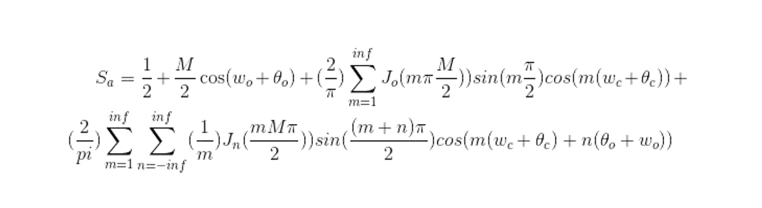
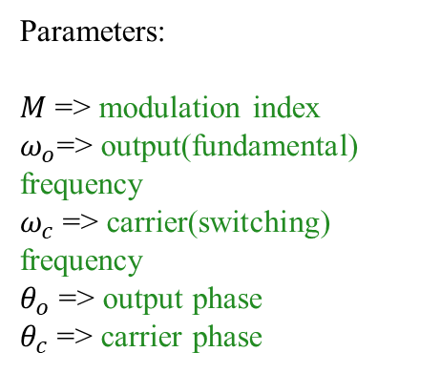


3-phase Utilization : External WPT Windings
Switching Harmonics
Bessel function ( $0$ order)
Fundamental
Component
Switching
Harmonics
Parameters:
$M$ => modulation index
$ω_{o}$=> output(fundamental) frequency
$ω_{c}$=> carrier(switching) frequency
$θ_{o}$ => output phase
$θ_{c}$ => carrier phase
Side Band harmonics
Bessel function ( $n^{th}$ order)
Deductions
Fundamental component is independent from carrier(switching) frequency and phase.
There is no even harmonics of the switching and the sign of the odd harmonics is alternated.
The switching harmonics are independent from fundamental frequency and phase.
The side band harmonics are affected by all fundamental and carrier frequency and phases.

Slide 11
Stator Winding Utilization : Basic EESM- 2 Pole
Linearized slot representation
 | A+ |  | C- |  | B+ |  | A- |  | C+ |  | B-
Stator
Stationary side
Harvesting coil
Rotating side
X
o
o
X
N
S
Rotor
Mutual inductances between stator windings and harvesting coil:
Phase A: Positive
Phase B: Positive
Phase C: Negative
They are rotation -independent if saturation ignored at this stage.

Slide 12
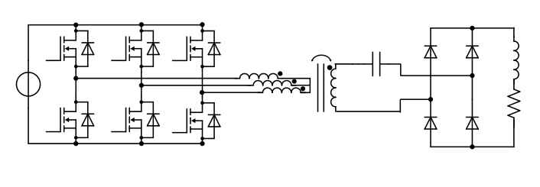

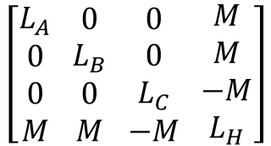


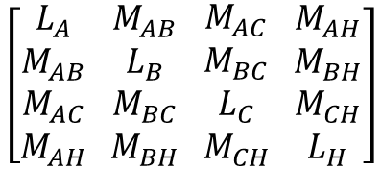






Tuned Harvesting Coil
$$Coupling$$
$$L_{A}$$
$$L_{F}$$
$$V_{DC}$$
$$L_{H}$$
$$C_{H}$$
$$L_{B}$$
$$L_{C}$$
$$R_{F}$$
$$\left[\begin{aligned}L_{A} \\ M_{AB} \\ M_{AC} \\ M_{AH}\end{aligned} \begin{aligned}M_{AB} \\ L_{B} \\ M_{BC} \\ M_{BH}\end{aligned} \begin{aligned}M_{AC} \\ M_{BC} \\ L_{C} \\ M_{CH}\end{aligned} \begin{aligned}M_{AH} \\ M_{BH} \\ M_{CH} \\ L_{H}\end{aligned}\right]$$
Simplified
Inductance Matrix
$$\left[\begin{aligned}L_{A} \\ 0 \\ 0 \\ M\end{aligned} \begin{aligned}0 \\ L_{B} \\ 0 \\ M\end{aligned} \begin{aligned}0 \\ 0 \\ L_{C} \\ −M\end{aligned} \begin{aligned}M \\ M \\ −M \\ L_{H}\end{aligned}\right]$$
Inductance Matrix

Slide 13
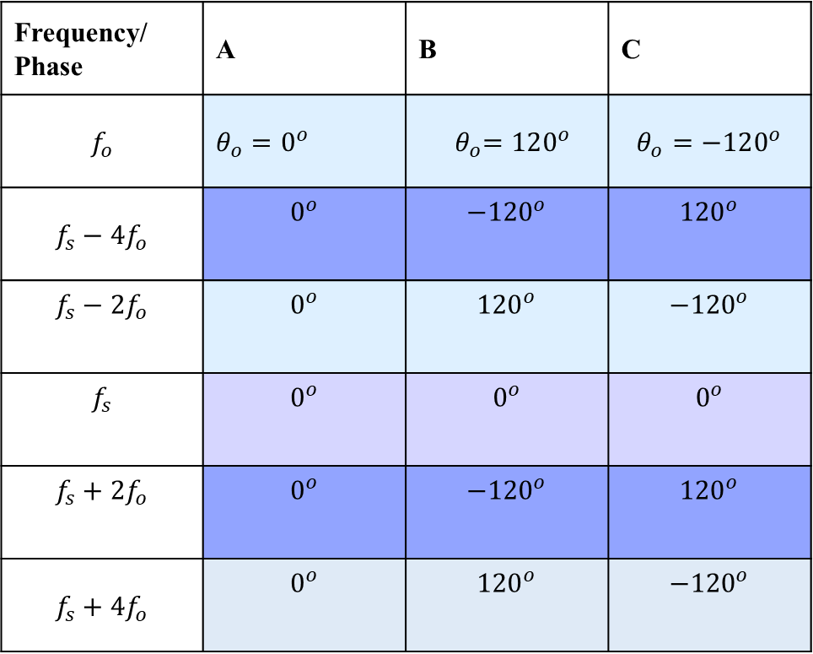
Switching Harmonics- Sequences
Frequency/ Phase | A | B | C
$$f_{o}$$ | $θ_{o}=0^{o}$ | $${ θ}_{o}=120^{o}$$ | $$θ_{o}=−120^{o}$$
$$f_{s}−4f_{o}$$ | $$0^{o}$$ | $${−120}^{o}$$ | $${120}^{o}$$
$$f_{s}−2f_{o}$$ | $$0^{o}$$ | $${120}^{o}$$ | $${−120}^{o}$$
$$f_{s}$$ | $$0^{o}$$ | $$0^{o}$$ | $$0^{o}$$
$$f_{s}+2f_{o}$$ | $$0^{o}$$ | $${−120}^{o}$$ | $${120}^{o}$$
$$f_{s}+4f_{o}$$ | $$0^{o}$$ | $${120}^{o}$$ | $${−120}^{o}$$

Slide 14





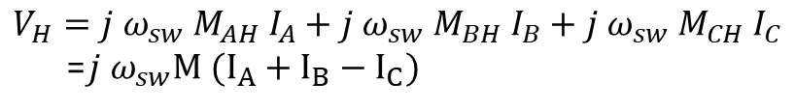


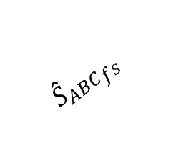

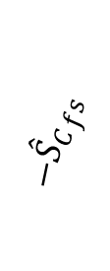
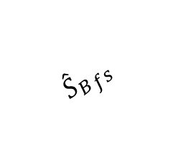

The Induced Superimposed Voltage
$$V_{H}=j ω_{sw} M_{AH} I_{A}+j ω_{sw} M_{BH} I_{B}+j ω_{sw} M_{CH} I_{C}$$
=$j ω_{sw}M (I_{A}+I_{B}−I_{C})$
$$I_{A}, I_{B}, I_{C}$$
Related switching functions, $S_{A}, S_{B}, S_{C}$
$| {{\hat{S}}_{B}}_{fs }+{{\hat{S}}_{C}}_{fs }|$
$$α=φ_{C−B}−φ_{C−A}$$
$| {{\hat{S}}_{B}}_{fs }$-${{\hat{S}}_{C}}_{fs }|$
$$β=−φ_{C−C}−φ_{C−B}$$
$$β$$
$${{\hat{S}}_{ABC}}_{fs }$$
$${{−\hat{S}}_{C}}_{fs }$$
$${{\hat{S}}_{B}}_{fs }$$
$$φ$$
$$α$$
$${{\hat{S}}_{A}}_{fs }$$
(a)
(b)
(c)

Slide 15






The Controllable Region of the Superimposed Voltage - SPWM
$$m_{a}=0$$
$$m_{a}=0.25$$
$$m_{a}=0.50$$
$$m_{a}=0.75$$
$$m_{a}=0.80$$
$$m_{a}=1$$

Slide 16




The Controllable Region of the Superimposed Voltage - SVPWM
$$m_{a}=0.50$$
$$m_{a}=0$$
$$m_{a}=0.25$$
$$m_{a}=0.75$$
$$m_{a}=1$$
$m_{a}=1$.1

Slide 17
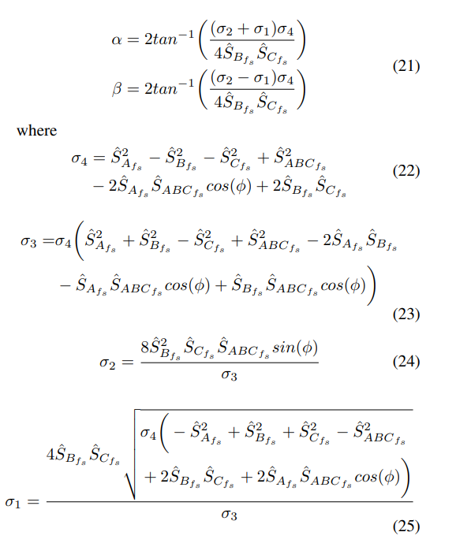
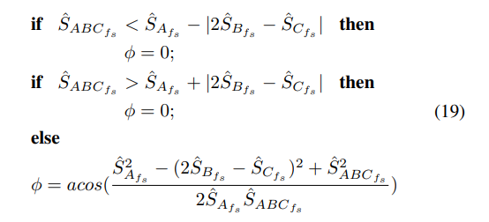
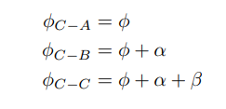
Challenge- Calculation Burden (Robotic Arm Kinematics)
Notes:
The WPT system is connected between phase-A and phase B.
By carrier phase shift to phase B, we achieve this contour of the magnitude of the switching frequency.
We can observe that we can have a constant gain for any modulation.
The constant gain is between 0.25 and 0.45 over a DC-link voltage.
The control diagram is shown.
We adjust the carrier phase shift according to modulation to control the WPT power.

Slide 18
References
Simultaneous Information/
Power Transfer
Selective
Power Transfer
Slip-Ring Applications
Single-Stage
Power Transfers
Concurrent Power Transfer
Simultaneous Wireless Information and Power Transfer (SWIPT): Recent Advances and Future Challenges (2018)
Integrated Resonant Structure for Simultaneous Wireless Power Transfer and Data Telemetry(2012)
A Simultaneous Wireless Power and Data Transmission Method for Multi-Output WPT Systems: Analysis, Design, and Experimental Verification (2020)
Selective Omnidirectional Magnetic Resonant Coupling Wireless Power Transfer With Multiple-Receiver System(2018)
Design and Analysis of Wireless Switched Reluctance Motor Drives(2019)
Frequency Splitting-Based Wireless Power Transfer and Simultaneous Propulsion Generation to Multiple Micro-Robots(2018)
Comparative Analysis of Frequency-Selective Wireless Power Transfer for Multiple-Rx Systems(2020)
A Frequency-Selective EMI Reduction Method for Tightly Coupled Wireless Power Transfer Systems Using Resonant Frequency Control of a Shielding Coil in Smartphone Application(2020)
Selective Wireless Power Transfer for Smart Power Distribution in a Miniature-Sized Multiple-Receiver System(2016)
A Multifrequency Superposition Methodology to Achieve High Efficiency and Targeted Power Distribution for a Multiload MCRWPT System(2018)
Cross Interference Minimization and Simultaneous Wireless Power Transfer to Multiple Frequency Loads Using Frequency Bifurcation Approach
A Primary-Side Control Method of Wireless Power Transfer for Motor Electric Excitation(2019)
Wireless DC Motor Drives with Selectability and Controllability(2017)
An Airborne Radar Power Supply With Contactless Transfer of Energy—Part I: Rotating Transformer (2007)
Aerodynamic Fluid Bearings for Translational and Rotating Capacitors in Noncontact Capacitive Power Transfer Systems(2014)
Synchronous Generator Brushless Field Excitation and Voltage Regulation via Capacitive Coupling Through Journal Bearings(2017)
Operation of an Electrical Excited Synchronous Machine by Contactless Energy Transfer to the Rotor(2018)
A Rotation-Lightweight Wireless Power Transfer System for Solar Wing Driving(2019)
Wireless Power Transfer for Smart Industrial and Home Applications(2019)
Use of the Rotating Rectifier Board as a Capacitive Power Coupler for Brushless Wound Field Synchronous Machines(2022)
A High-Efficiency GaN-Based Single-Stage 6.78 MHz Transmitter for Wireless Power Transfer Applications(2019)
Cooperative Integration of RF Energy Harvesting and Dedicated WPT for Wireless Sensor Networks(2019)
A Three-Phase Single-Stage AC–DC Wireless-Power-Transfer Converter With Power Factor Correction and Bus Voltage Control(2020)
Individually Regulated Multiple-Output WPT System With a Single PWM and Single Transformer (2020)
Multifrequency Inductive Power Transfer(2014)
Wireless Power Transfer With Concurrent 200-kHz and 6.78-MHz Operation in a Single-Transmitter Device (2016)
Gan-Based Dual-Mode Wireless Power Transfer Using Multifrequency Programmed Pulse Width Modulation (2017)
A Multifrequency Superposition Methodology to Achieve High Efficiency and Targeted Power Distribution for a Multiload MCRWPT System (2018)
Cross Interference Minimization and Simultaneous Wireless Power Transfer to Multiple Frequency Loads Using Frequency Bifurcation Approach(2019)
A Gallium Nitride (GaN)-Based Single-Inductor Multiple-Output (SIMO) Inverter With Multi-Frequency AC Outputs (2019)
Single-Inductor Multiple-Output (SIMO) Buck Hybrid Converter for Simultaneous Wireless and Wired Power Transfer(2020)
Generalized methodology to generate, amplify and compensate multi-frequency power for a single-inverter-based MF-MR-S-WPT system (2020)
Concurrent Wireless Power Transfer to Multiple Receivers With Additional Resonant Frequencies and Reduced Power Switches (2020)
Multifrequency and Multiload MCR-WPT System Using Hybrid Modulation Waves SPWM Control Method (2021)
Multi-Frequency Multi-Amplitude Superposition Modulation Method With Phase Shift Optimization for Single Inverter of Wireless Power Transfer System (2021)
Design and Control of a Decoupled Multichannel Wireless Power Transfer System Based on Multilevel Inverters (2022)
A Dual-Frequency Three-Dimensional WPT System with Directional Power Transfer Capability at Two Separately Regulated Outputs (2022)

Slide 20



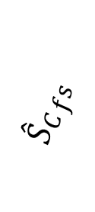





$$β$$
$${{\hat{S}}_{C}}_{fs }$$
$${{\hat{S}}_{ABC}}_{fs }$$
$${{\hat{S}}_{B}}_{fs }$$
$$φ$$
$$α$$
$| {{\hat{S}}_{B}}_{fs}+{{\hat{S}}_{C}}_{fs }|$
$${{\hat{S}}_{A}}_{fs }$$
(a)
$| {{\hat{S}}_{B}}_{fs}$-${{\hat{S}}_{C}}_{fs }|$
(a)
(b)

Slide 21





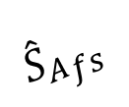








$$β$$
$${{\hat{S}}_{B}}_{fs }$$
$$α$$
$${{\hat{S}}_{C}}_{fs }$$
$${{\hat{S}}_{B}}_{fs }$$
$${{\hat{S}}_{A}}_{fs }$$
$${{\hat{S}}_{A}}_{fs }$$
$$α$$
$$φ$$
$$φ$$
$${{\hat{S}}_{ABC}}_{fs }$$
$${{\hat{S}}_{ABC}}_{fs }$$
(a)
(b)
$| {{\hat{S}}_{B}}_{fs}+{{\hat{S}}_{C}}_{fs }|$
$| {{\hat{S}}_{B}}_{fs}$-${{\hat{S}}_{C}}_{fs }|$
(a)
(b)

Slide 22
https://www.ew.tu-darmstadt.de/media/ew/rd/ew_vortraege/kurs_gec/gec_4.pdf

